Slide 1

Plumbers & Steamfitters Local 486 – 1Q19
May 13th 2019

Slide 2
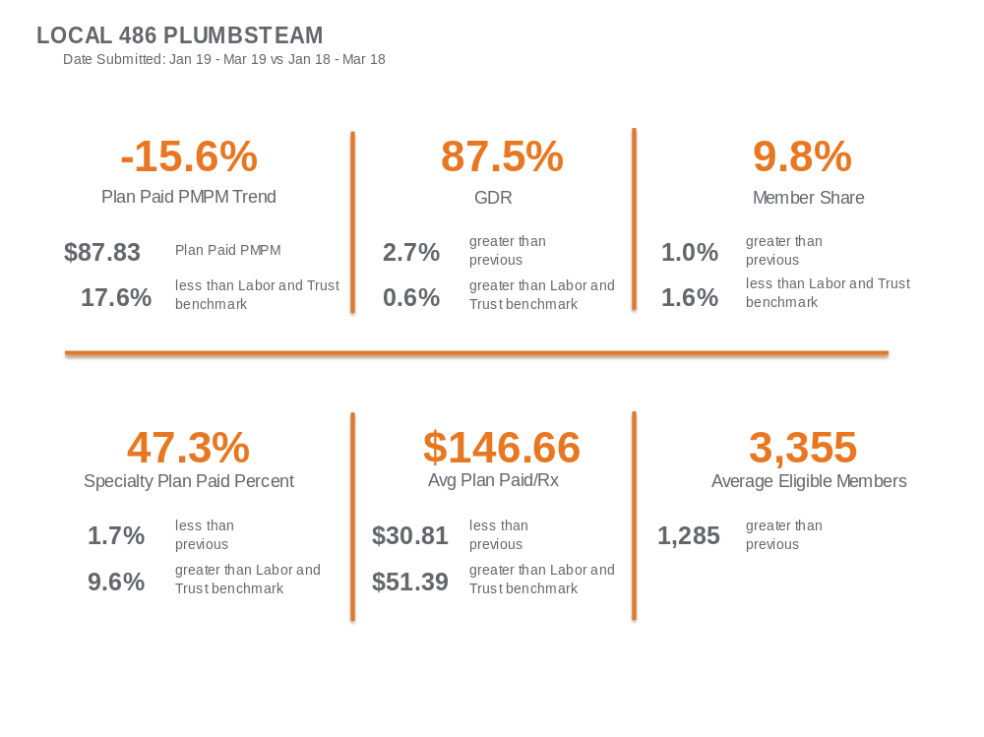

Slide 3
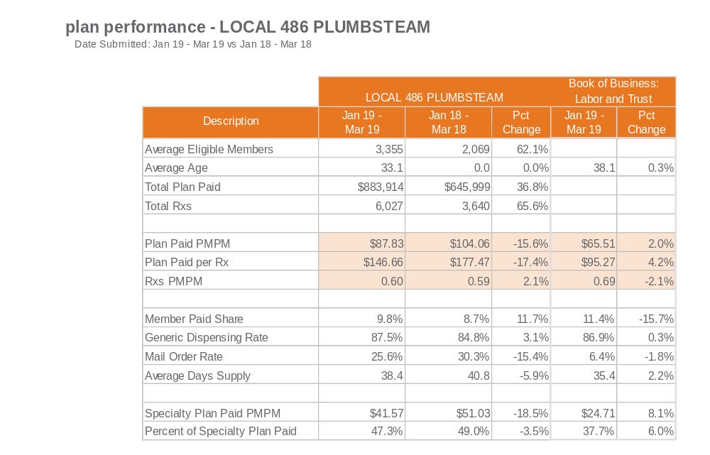

Slide 4
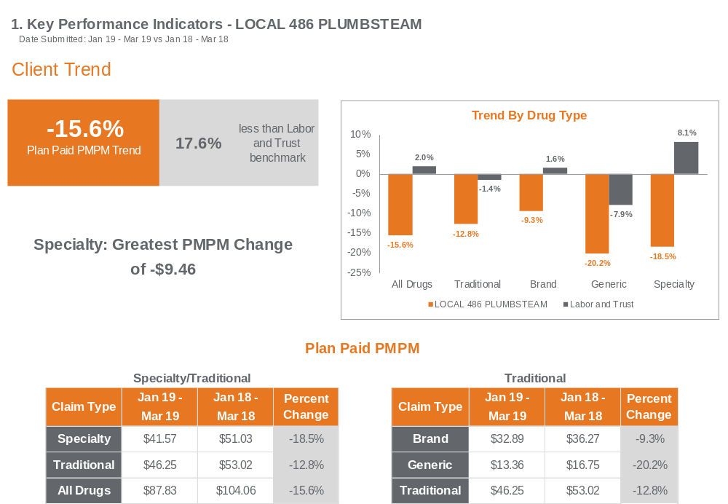

Slide 5
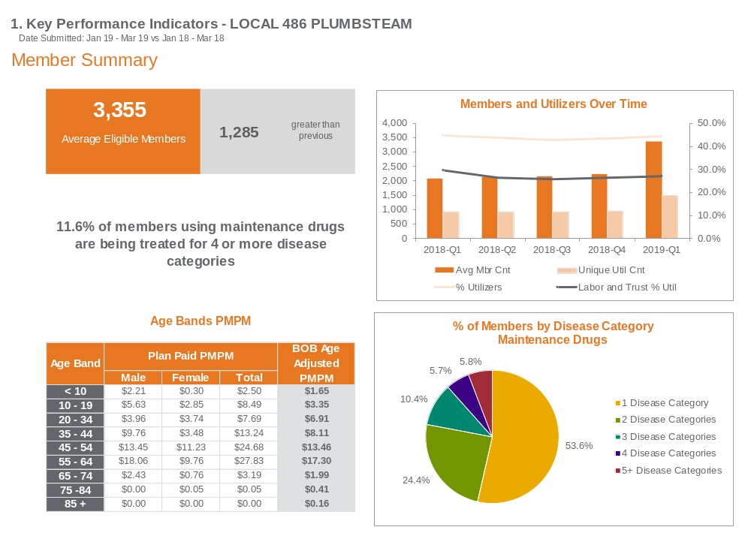
46% of your population is being treated for more than one
Disease.

Slide 6
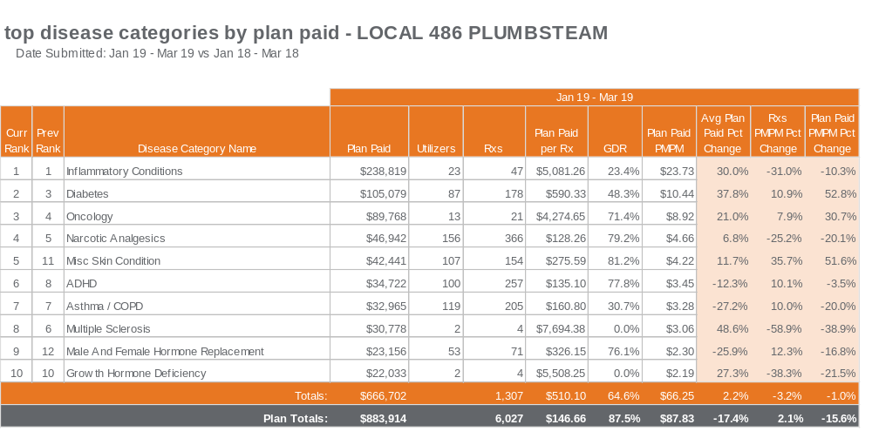
Diabetes moved up 1 in current rank
and plan paid PMPM % change is 52.8%.
2018 total utilizers 79 and in 1Q19 increased
to 87.

Slide 7
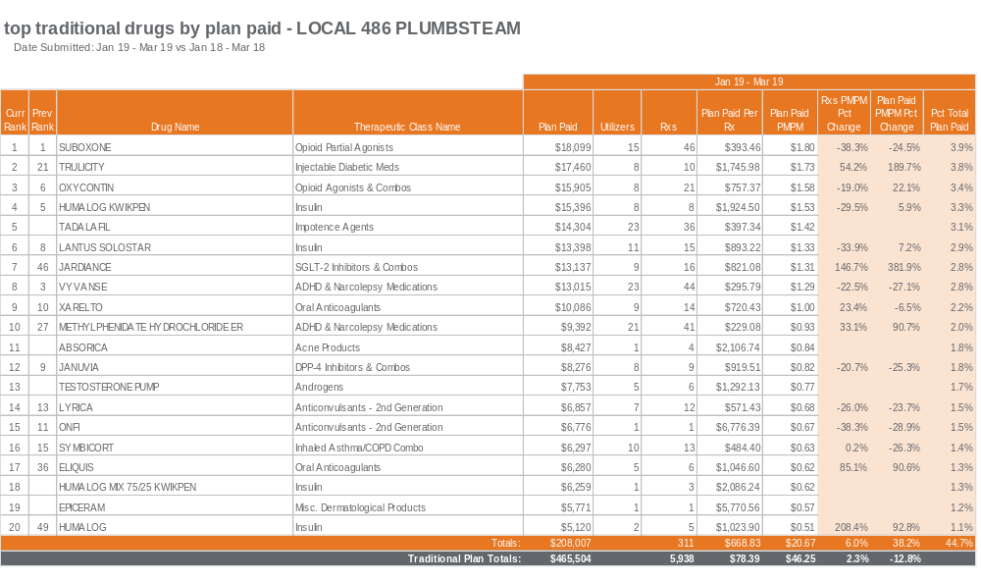

Slide 8
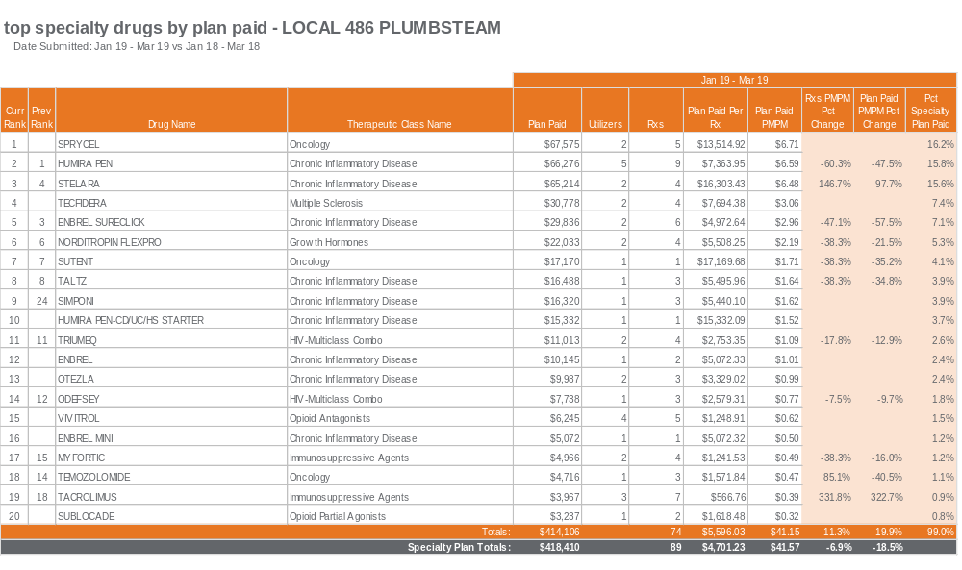

Slide 9
9. Appendix

Slide 10
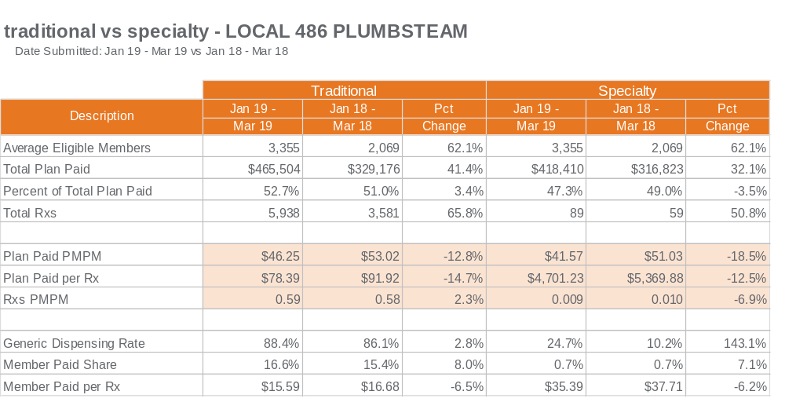

Slide 11
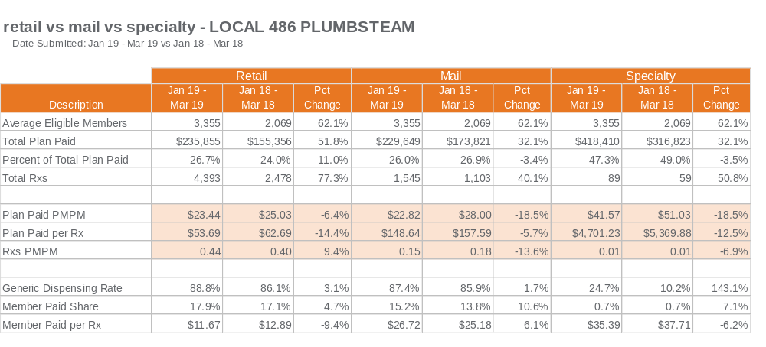

Slide 12
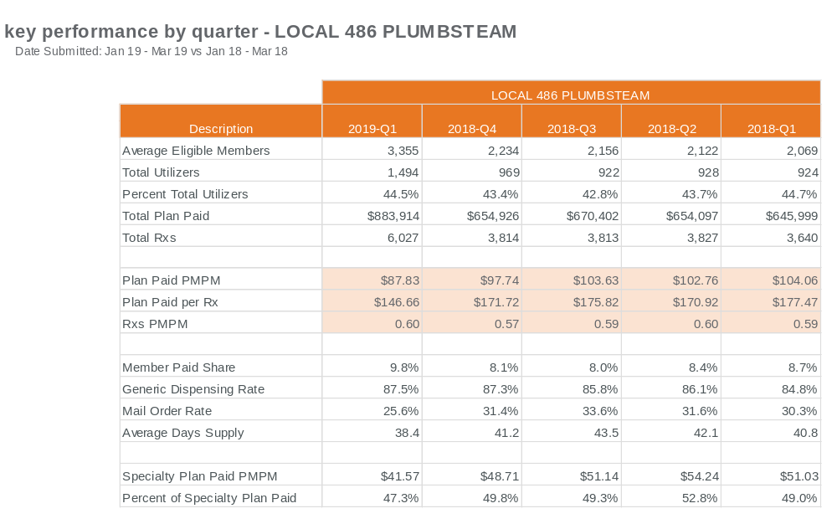

Slide 13
